Slide 1
Presentation on Git
Abhishek Kumar Jha
https://github.com/jhaabhishek115

Slide 2
What is Git?
Git is a distributed version control and source code management system with an emphasis on speed. Git was initially designed and developed by Linus Torvalds for Linux kernel development.
Version Control System (VCS) is a software that helps to implement SCM in software development lifecycle
VCS can be classified into two types:
Centralized version control system (CVCS) : Centralized version control system (CVCS) uses a central server to store all files and enables team collaboration.
But the major drawback of CVCS is its single point of failure, i.e., failure of the central server. Unfortunately, if the central server goes down for an hour, then during that hour, no one can collaborate at all.

Slide 3
Git is a Decentralized VCS
Distributed/Decentralized version control system (DVCS)
There is no server in DVCS and everything is a workspace. Every workspace will have a complete copy of the actual repository. If the central server/repository goes down, then the repository from any client can be copied back to the server to restore it.
Git does not rely on the central server and that is why you can perform many operations when you are offline. You can commit changes, create branches, view logs, and perform other operations when you are offline. You require network connection only to publish your changes and take the latest changes.

Slide 4
SCM Terminologies
Server: Server is a machine which holds the collection of all the changes for every product. Server contains many repositories in it.
Repository: Folder or location under server where all the changes specific to project is stored.
Client: Client is a software which connects to the server assisting users to perform necessary actions
Workspace: Is a folder in your local machine where we you see the files respective to a repository in the server, modify them

Slide 5
Checkout: An action which helps us to fetch the files from the repository and displays in the workspace, which are later modified
Checkin: An action where the changes made in the workspace are stored back in the repository
Versions: References created in the repository for every checkin, which holds the transaction details of who modified, what was modified and when was it modified

Slide 6
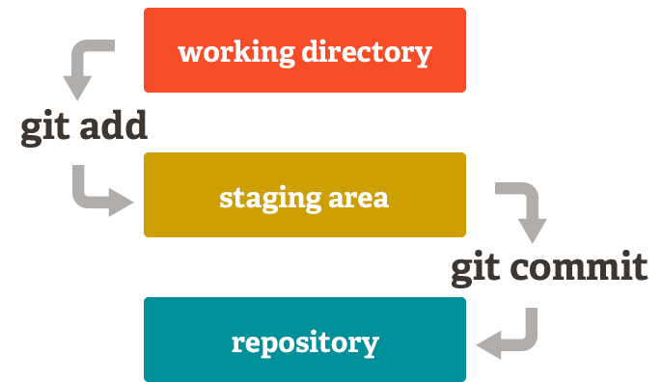
Git Local Workspace
Git local workspace has three areas:

Slide 7
Git Local Workspace
Working directory is the folder where we see the files and modify them
The changes are then pushed to Staging area where snapshots would be taken
We then perform commit operation that moves the contents from the staging area and stores it into the repository by creating a commitID

Slide 8
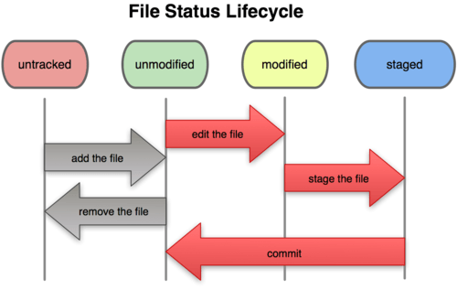
Git File Status Lifecycle

Slide 9
Git File Status Lifecycle
All new files are considered untracked, any files under the repository are called tracked files.
However files status would be unmodified if it’s a clone workspace and changes are done.
Status would be modified if files are modified compared to repository content.
Once the changes are moved to staging area the file status will be staged.
When these changes are checkedin the file status would be unmodified.

Slide 10
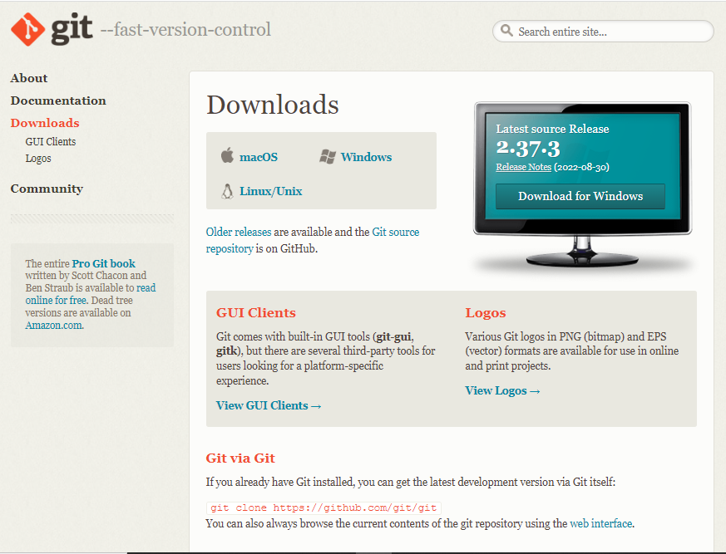
Git Installation
Go to https://git-scm.com/downloads and choose appropriate platform to install Git.

Slide 11
Git Installation
Installing Git on Windows
Download exe from the above mentioned page and install it on windows.
Installing Git on Linux
For Ubuntu/Debian OS, run the following as ‘root’
$ apt install git
For Centos/Fedora OS
$ yum install git

Slide 12
Git Setup
Set the user configuration i.e name and email for Git to use when you commit.
Open gitbash command prompt and run the following cmds:
$ git config --global user.name “Adam M”
$ git config --global user.email mailme@wezva.com

Slide 13
Setting Up Remote Repository locally
Bare repository contains the version control information and no working files. By convention the name of a bare repository should end with the .git extension.
Create a new directory & run the following from it:
$ mkdir demo.git
$ cd demo.git
$ git init

Slide 14
Git Lifecycle
General workflow is as follows:
• You clone the Git repository as a working copy.
• You modify the working copy by adding/editing files.
• If necessary, you also update the working copy by taking other developers' changes.
• You review the changes before commit.
• You commit changes. If everything is fine, then you push the changes to the repository.
• After committing, if you realize something is wrong, then you correct the last commit and push the changes to the repository.

Slide 15
Git User Workflow
git clone <CentralRepoURL> <Local Directory>
Once the workspace is created, cd to the dir & make changes
Show the list of all new files or modified files
git status
Add changes to the staging area
git add .

Slide 16
Checkin the changes permanently to repository
git commit –m “<commit message>”
Show the list of all the commit id’s from latest to oldest order
$ git log # lists all the commits in full format
$ git log --oneline # lists all the commits in short format
$ git log –oneline -<num> # lists only the specified number of commit ids
Share the modified commits from local to central repository
$ git push

Slide 17
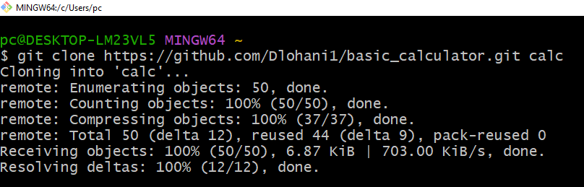
Clone the repository

Slide 18
Git Branches
A branch represents an independent line of development.
The default branch name in Git is master.
As you initially make commits, you’re given a master branch that points to the last commit you made.
Every time you commit, it moves forward automatically.
Show the list of all branches:
$ git branch
$ git branch –a # lists the branches which are in remote repository
Create a new branch:
$ git branch <NewBranchName>
Swtich to a particular branch
$ git checkout <BranchName>

Slide 19
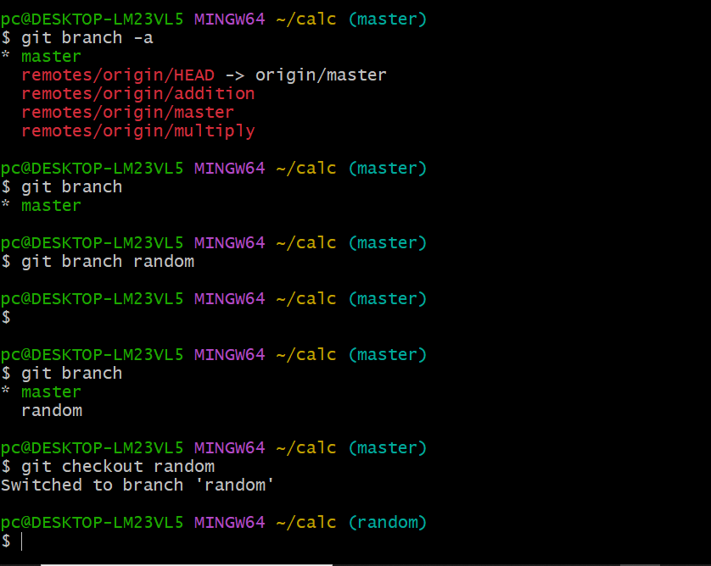

Slide 20
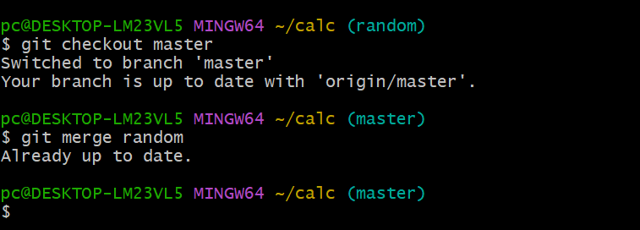
Git Merge
Git merge will combine multiple sequences of commits into one unified history.
Git merge will take the commits from a source branch and update the target branch by integrating its existing commits.
While merging branches, it’s a best practice to be on the destination branch.

Slide 21
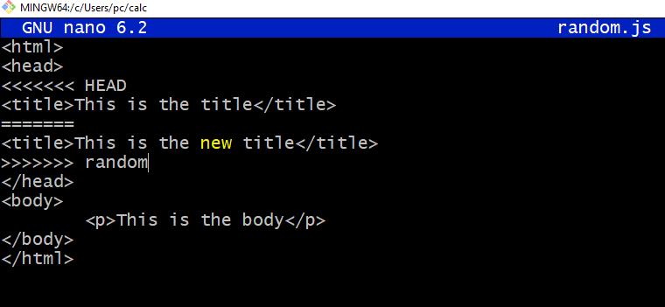
Resolving merge conflicts
If the two branches you're trying to merge both changed the same part of the same file, Git won't be able to figure out which version to use.
When such a situation occurs, it stops right before the merge commit so that you can resolve the conflicts manually.

Slide 22
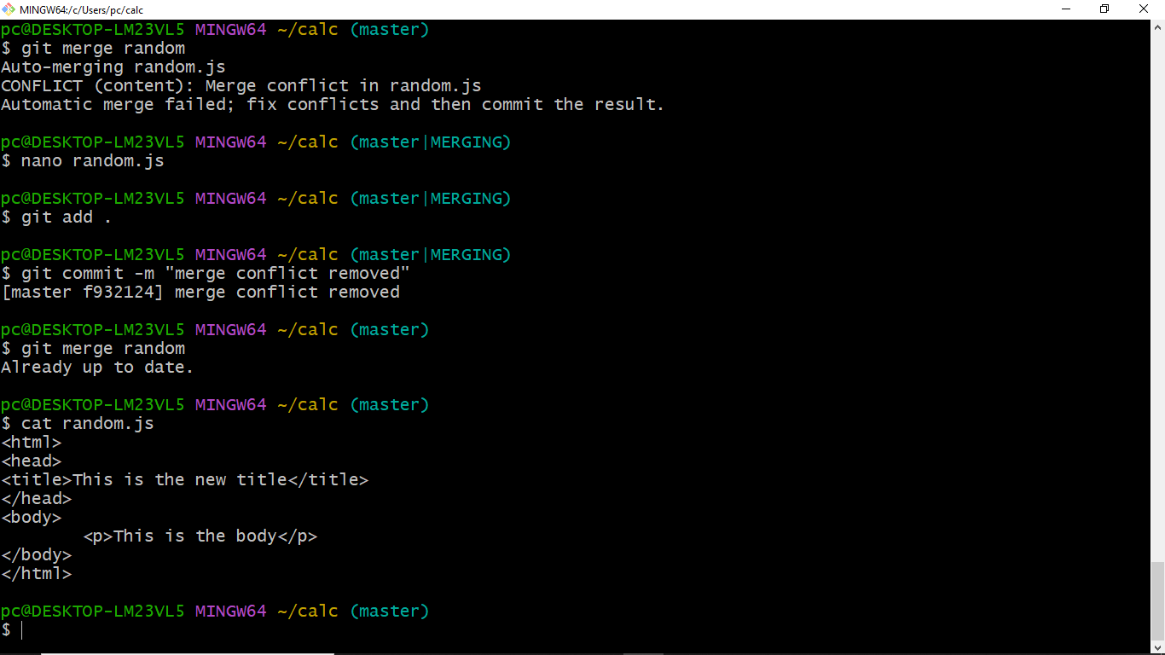

Slide 23
Branching Methodology
Instead of committing directly on the local master branch, developers create a new branch every time they start work on a new feature.
Feature branches should have descriptive names for identification.
Git makes no technical distinction between the master branch and feature branches, so developers can edit, stage, and commit changes to a feature branch.
In addition, feature branches can (and should) be pushed to the central repository. This makes it possible to share a feature with other developers without touching any official code

Slide 24
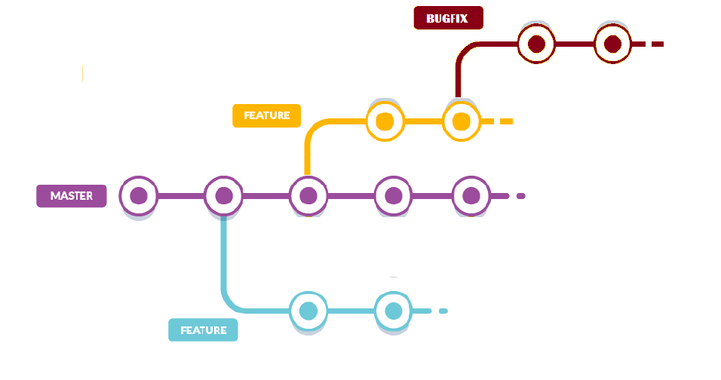
Branching Methodology

Slide 25
Git stash
git stash temporarily shelves (or stashes) changes you've made to your working copy so you can work on something else, and then come back and re-apply them later on.
Stashing is handy if you need to quickly switch context and work on something else, but you're mid-way through a code change and aren't quite ready to commit.
Stashing will record untracked files.
Create stash – take a backup & undo the change
$ git stash

Slide 26
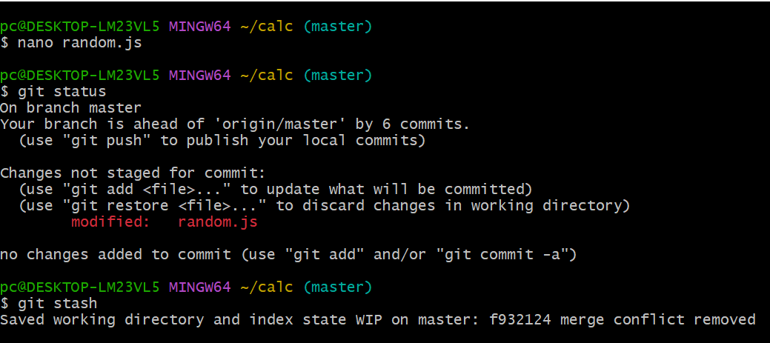

Slide 27
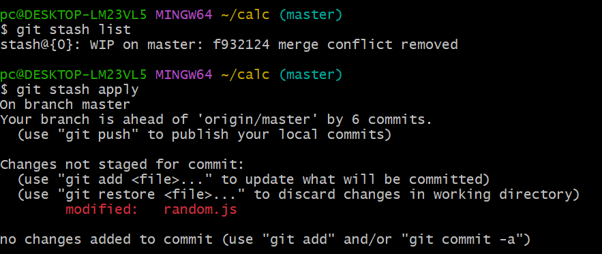
List all the available backup for the repository
$ git stash list

Slide 28
Undo uncommitted changes
Undoing changes doesn’t just happen from only the files, since Git has 3 working areas the changes has to be reverted from all the 3 areas respectively.
Before committing any change if we need to undo the changes then use reset
Syntax:
$ git reset <file> --[mode]
Where mode is “soft/mixed/hard”
Undo changes from the repository & move reference of HEAD pointer
$ git reset --soft

Slide 29
Revert committed changes
The git revert command can be considered an 'undo' type command, however, it is not a traditional undo operation.
Instead of removing the commit from the project history, it figures out how to invert the changes introduced by the commit and appends a new commit with the resulting inverse content.
This prevents Git from losing history, which is important for the integrity of your revision history and for reliable collaboration.
A revert operation will take the specified commit, inverse the changes from that commit, and create a new "revert commit".
The ref pointers are then updated to point at the new revert commit making it the tip of the branch.

Slide 30
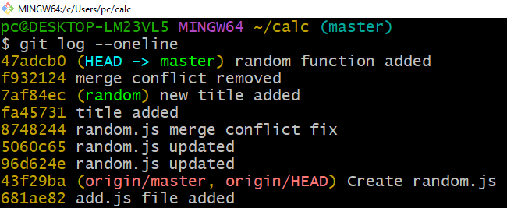
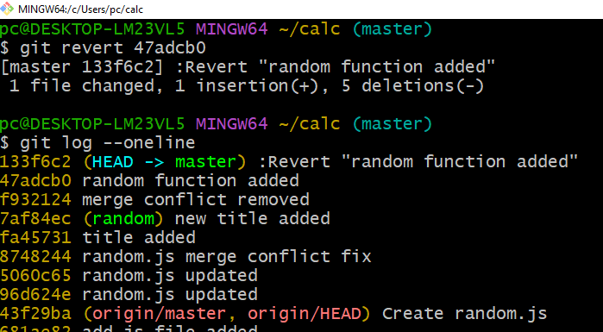
$ git revert 47adcb0

Slide 31
Ignoring certain files
Git by default considers all the files under the working dir & an gitignore file specifies intentionally untracked files that Git should ignore.
Files already tracked by Git are not affected ‘
Git never ignores files which are already tracked, so changes in the .gitignore file only affect new files. Commit the .gitignore to the Git repository as a best practice.

Slide 32
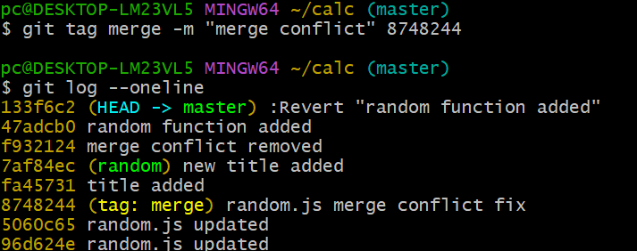
Tags
Git has the option to tag a commit in the repository history so that you find it easier at a later point in time.
A single commitID can have many tags, whereas a tag name cannot be attached to multiple commits.
Create & Apply a tag

Slide 33
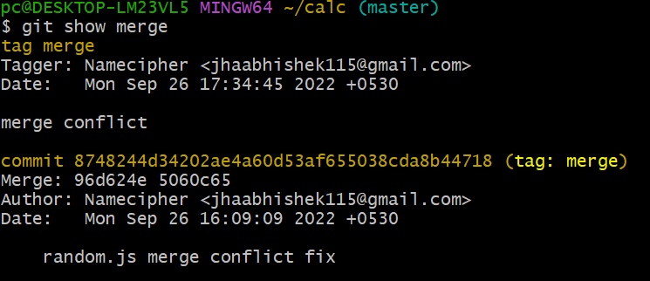
Show the contents of the tag
git show merge

Slide 34

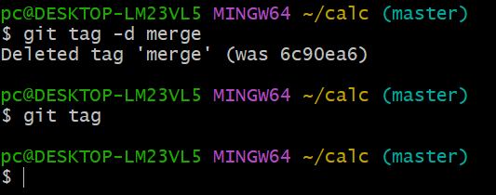
List all the available tags
$ git tag
Delete a tag
$ git tag –d merge

